Slide 1



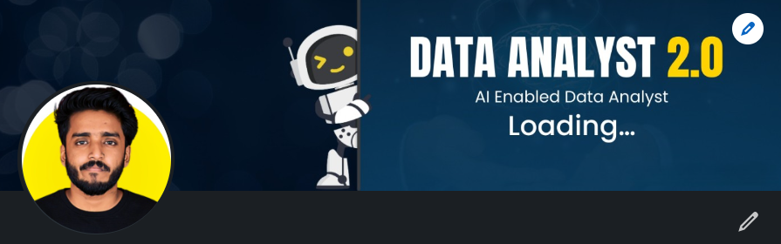
Wavecon Telecom Analysis
5G LAUNCH IMPACT ON WAVECON'S REVENUE
Presented by : Sriraj Acharya
Notes:
Hello, I’m Sriraj Acharya, a data analyst intern at Atlitechnology. Today, I will present my project titled 'WAVECON TELECOM ANALYSIS: 5G LAUNCH IMPACT ON WAVECON'S REVENUE.'
We will analyze the data to answer key questions about how the 5G launch has affected Wavecon’s revenue. This analysis explores the significant impact of 5G technology on Wavecon's revenue. We will look at key metrics, trends, and forecasts to understand how 5G adoption has reshaped market dynamics and revenue opportunities for Wavecon.
Thank you for your attention, and let's dive into the analysis."

Slide 2


Introduction
Wavecon, a leading telecom provider in India, introduced its 5G services in May 2022 across major cities alongside other telecom companies. This analysis examines the performance of Wavecon's 5G rollout in 15 key urban centers Mumbai , Delhi , Bangalore, Hyderabad, aiming to uncover insights into the impact of 5G on revenue, plan performance, and key performance indicators (KPIs). The findings will inform strategic decisions for future growth and optimization.
Notes:
Wavecon, a top telecom company in India, launched its 5G services in May 2022 in major cities like Mumbai, Delhi, Bangalore, and Hyderabad. This analysis looks at how well Wavecon's 5G rollout performed in these 15 cities. It aims to find out how 5G affected revenue, plan performance, and other key measures. The results will help make smarter decisions for future growth and improvements.

Slide 3
Objectives
What is the impact of the 5G launch on our revenue?
2.Which KPI is underperforming after the 5G launch?
3.After the 5G launch, which plans are performing well in terms of revenue? Which plans are not performing well?
4.Is there any plan affected largely by the 5G launch? Should we continue or discontinue that plan?
5.Is there any plan that is discontinued after the 5G launch? What is the reason for it?`
Notes:
What is the impact of the 5G launch on our revenue?
2.Which KPI is underperforming after the 5G launch?
3.After the 5G launch, which plans are performing well in terms of revenue? Which plans are not performing well?
4.Is there any plan affected largely by the 5G launch? Should we continue or discontinue that plan?
5.Is there any plan that is discontinued after the 5G launch? What is the reason for it?`

Slide 4

Dashboard

Slide 5




1.What is the impact of the 5G launch on revenue ?
Revenue Dip
Before 5G was launched, Wavecon's revenue was $16 billion. After the launch, revenue dropped slightly to $15.9 billion. This suggests a need to investigate what caused this change and find ways to increase revenue.
Notes:
Before launching 5G, Wavecon had a revenue of $16 billion. After the launch, this dropped slightly to $15.9 billion. This small decrease suggests that something might have gone wrong, so it's important to investigate why this happened. By understanding the reasons, Wavecon can find ways to increase revenue and make the most of the new 5G technology. By examining market dynamics, customer behavior, and competitive actions, Wavecon can pinpoint specific areas for improvement and implement targeted measures to boost revenue and capitalize on the opportunities presented by 5G technology.

Slide 6





2. Which KPI is underperforming after the 5G launch?
Total Revenue
Total revenue slightly decreased from $16 billion to $15.9 billion.
Active Users
The active user base decreased from 84.4 million to 77.4 million
Total Unsubscribed Users
The total number of unsubscribed users increased from 5.6 million to 7 million
Notes:
Total revenue dropped slightly from $16 billion to $15.9 billion. Additionally, the number of active users decreased from 84.4 million to 77.4 million, and the number of unsubscribed users rose from 5.6 million to 7 million. This indicates a few key issues: fewer people are using Wavecon's services, and more people are leaving. To address this, it's important to investigate the reasons behind these changes.
Understanding why users are leaving and fewer new users are joining can help identify areas for improvement. This could involve looking into customer satisfaction, the competitiveness of the 5G offerings, and the overall market conditions. By addressing these issues, Wavecon can develop strategies to attract new users, retain existing ones, and ultimately increase revenue. This might include improving service quality, offering better deals or incentives, and enhancing customer support.

Slide 7


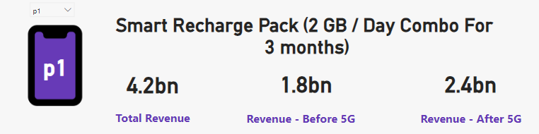
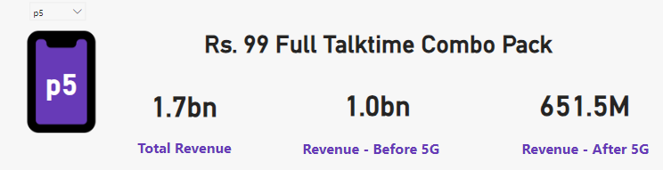
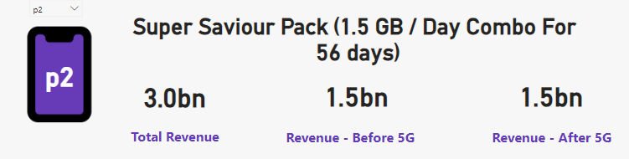
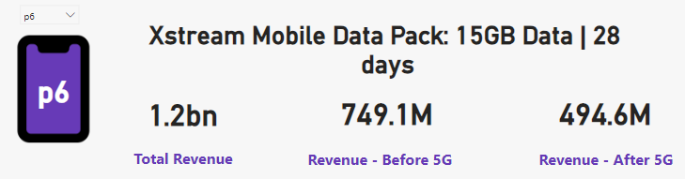
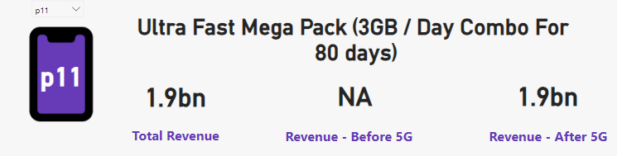
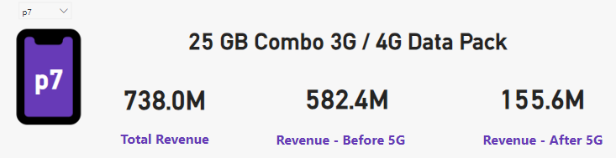
3.After the 5G launch, which plans are performing well in terms of revenue? Which plans are not performing well?
Good performing Plan After 5G Launch
Bad performing Plan After 5G Launch

Slide 8
4. Is there any plan affected largely by the 5G launch? Should we continue or discontinue that plan?
P1: Smart Recharge Pack (2 GB / Day Combo for 3 Months)
Revenue Before: $1.8 billion
Revenue After: $2.4 billion
P11: Ultra Fast Mega Pack (3GB / Day Combo for 80 Days)
Revenue: $1.9 billion
New plan launched during the 5G launch, performing well.
P12: Ultra Duo Data Pack (1.8GB / Day Combo for 55 Days)
Revenue: $1.2 billion
New plan launched during the 5G launch, performing well.
P7: 25 GB Combo 3G / 4G Data Pack
Revenue Before: $582.4 million
Revenue After: $155.6 million
Positive Impact
Negative Impact

Slide 9
5.Is there any plan that is discontinued after the 5G launch? What is the reason for it?
1. P8: Daily Saviour (1 GB / Day)
Validity: 1 Day
Reason for Discontinuation: The 1GB data plan with a 1-day validity period is insufficient for the increased data consumption driven by 5G technology. Consumers now demand plans with more data and longer validity periods.
2. P9: Combo Top-Up (14.95 Talktime and 300 MB Data)
Reason for Discontinuation: With the rise of 5G, consumer preferences have shifted away from plans offering limited talk time and minimal data. The faster speeds of 5G have increased data consumption, making such limited plans impractical. Additionally, Wavecon offers the P5 (Rs. 99 Full Talktime Combo Pack), which provides better value.
3. P10: Big Combo Pack (6 GB / Day)
Validity: 3 Days
Reason for Discontinuation: Despite offering a significant amount of data, the short validity period of only 3 days made this plan less appealing to consumers. This could be the reason Wavecon decided to discontinue this plan.
Notes:
Wavecon has discontinued three plans after the 5G launch, each for specific reasons related to changes in consumer behavior and increased data consumption due to faster 5G speeds.
Plan P8 - Daily Saviour (1 GB/Day, Validity: 1 Day)
Reason for Discontinuation:
A plan offering just 1 GB of data with a validity of only one day is no longer sufficient in the 5G era. With the advent of 5G technology, data consumption has surged dramatically due to faster download and upload speeds. Users now require more data to support their increased usage, which includes streaming high-definition videos, online gaming, and using data-intensive applications. Therefore, the limited data and short validity period of Plan P8 do not meet the current needs of consumers, leading to its discontinuation. Customers are now looking for plans that provide more data and longer validity to support their daily internet activities.
Plan P9 - Combo Top-Up (₹14.95 Talktime and 300 MB Data)
Reason for Discontinuation:
Following the introduction of 5G, consumer preferences shifted away from plans with limited talk time and minimal data. The 300 MB data offered by this plan is insufficient given the increased data consumption associated with 5G speeds. Moreover, Wavecon already offers a more comprehensive plan, P5 (₹99 Full Talktime Combo Pack), which provides better value with more talk time and data. As a result, the minimal data and limited talk time of Plan P9 no longer appeal to users, prompting Wavecon to discontinue it. Consumers now prefer plans that offer substantial data and talk time to meet their higher usage demands.
Plan P10 - Big Combo Pack (6 GB/Day, Validity: 3 Days)
Reason for Discontinuation:
Although Plan P10 provided a significant amount of data (6 GB per day), its short validity period of only three days made it less attractive to consumers. Users prefer plans that offer not only ample data but also longer validity to avoid the hassle of frequent recharges. The limited three-day validity period meant that users had to renew their plan often, which is inconvenient. As consumer preferences lean towards plans that balance substantial data allowances with longer validity periods, Wavecon decided to discontinue Plan P10. Customers now seek plans that provide both high data volumes and extended durations to support their continuous online activities without frequent interruptions.
Conclusion
The discontinuation of these plans reflects a shift in consumer needs and preferences following the launch of 5G technology. With the increased data consumption enabled by faster speeds, users now demand plans that offer more data and longer validity periods. Wavecon's decision to discontinue these outdated plans allows the company to focus on offering more suitable and competitive plans that better align with current consumer demands.

Slide 10


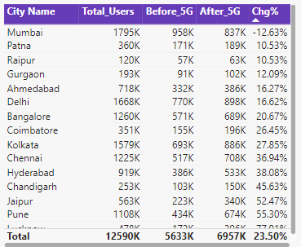

Recommendation
1. Enhancing Underperforming Plans for Revenue Growth
2. Total Unsubscribed Users (TUSU change)
Notes:
Wavecon should improve underperforming plans like Plan 5, Plan 6, and especially Plan 7 to boost revenue.
Analyze Performance: Check how these plans are performing and gather customer feedback.
Adjust Pricing: Change prices or offer promotions to make the plans more attractive.
Enhance Plans: Add more data or benefits and extend validity to meet user needs.
Market Research: Understand customer preferences and study competitors.
Investigate Coverage: Check if Mumbai has weaker network coverage compared to other cities.Improve Network: Work on strengthening the network infrastructure in Mumbai.Develop New Strategies: Create targeted plans or promotions to retain users in Mumbai and attract new ones.

Slide 11


Recommendation
3.Success and Future Growth of Top Performing Plan

Slide 12
Thank You
Notes:
Summary: Today, we discussed the performance of various plans, identified opportunities for optimization, and highlighted successful strategies.
Next Steps: We recommend focusing on improving underperforming plans and expanding successful ones.
Gratitude: Thank you for your attention and engagement.

